Slide 1


Analytical CRM Development for a Bank
By –
Shubham Jaiswal

Slide 2
Introduction
Banks play a crucial role in the financial stability and economic growth of societies. They provide essential services such as savings and checking accounts, loans, mortgages, and investment products to individuals and businesses. In a highly competitive market, maintaining strong relationships with customers is vital for a bank’s success. This is where Customer Relationship Management (CRM) comes into play.
Customer Relationship Management (CRM) in banking is a strategic approach that focuses on creating and maintaining long-term relationships with customers. It involves using technology and data to understand customer needs, preferences, and behaviors. By leveraging CRM systems, banks can provide personalized services, enhance customer satisfaction, and build loyalty

Slide 3
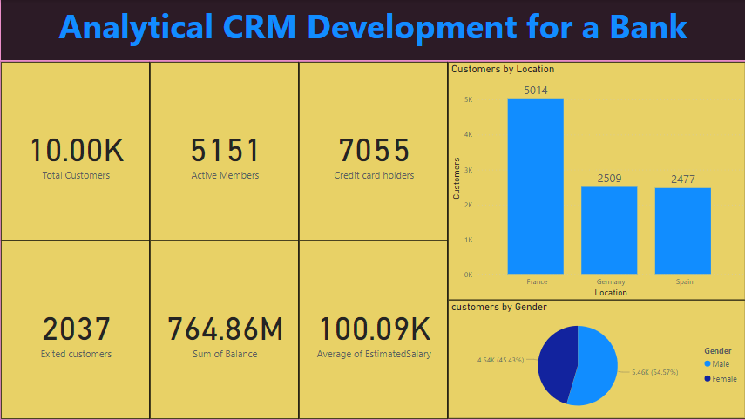
Bank Customers

Slide 4
Bank Customers
From the above graph we can see the total number of customers and some details about their journey with bank.
Bank has a total of 10000 customers in which 7963 customers are still with the bank.
Out of these 7963 customers 5151 customers are active and rest of them are inactive
7055 customers have credit card
All these customers collectively have 764.86 million of amount in their bank balance.
The bank have customers from 3 countries France, Germany & Spain

Slide 5
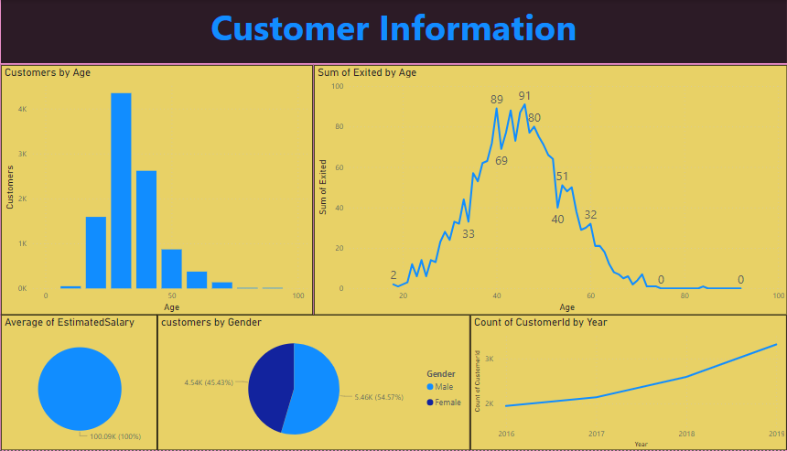
Customers Details
.

Slide 6
Customers Details
From the above graph we can see that most of the customers are from the age group of 30-40.
The bank has 5457 male customers & 4543 female customers.
Bank has 5014 customers from France , 2509 from Germany & 2477 from Spain.
These customers have an average of 100.09k estimated salary.

Slide 7
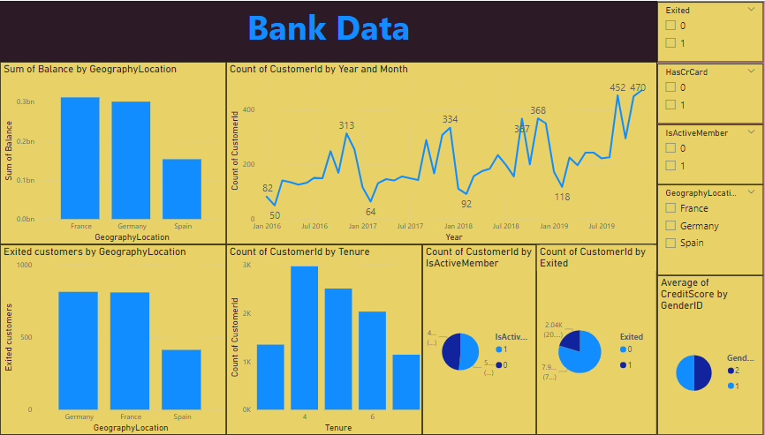
Bank Churn

Slide 8
Bank Churn
The bank churn are the most disturbing factor for a bank. It should be reduced by them to maintain their profit.
Some of the churn data are –
Customers who left the bank by the country –
France - 810
Spain - 413
Germany - 814

Slide 9
Bank Churn
Customers who left the bank and had a credit card – 1424
Customers tenure before leaving the bank –
3 years – 276
4 years – 575
5 years – 550
6 years – 418
7 years – 218

Slide 10
Bank Churn
Distribution of account balances around different regions –
France – 311332479.49
Spain – 153123552.01
Germany – 300402861.38
Average number of product used by customers who have a credit card is 1.5314

Slide 11
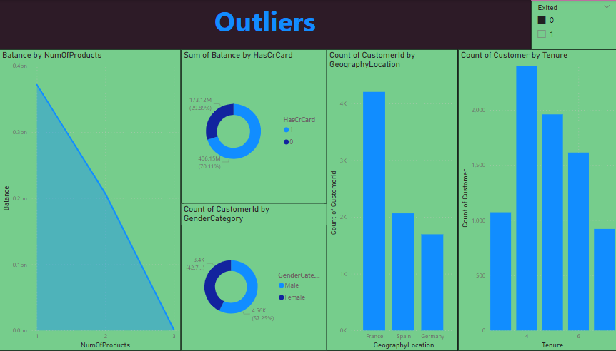
Outliers

Slide 12
Outliers
If we will notice the above graphs we will notice that people who are remained with bank have following outliers –
They use mostly 1 product
Most of the customers are those who have completed 4 years with bank
Most of the customers have credit card
Many of the customers are from France
More than half of the customers are male

Slide 13
Credit segment of bank
The bank has five category of customer according to their credit score –
Poor (<580) – 2362
Fair (580-700) – 3331
Good (700-740) – 2428
Very good (740-800) – 1224
Excellent (>800) – 655

Slide 14
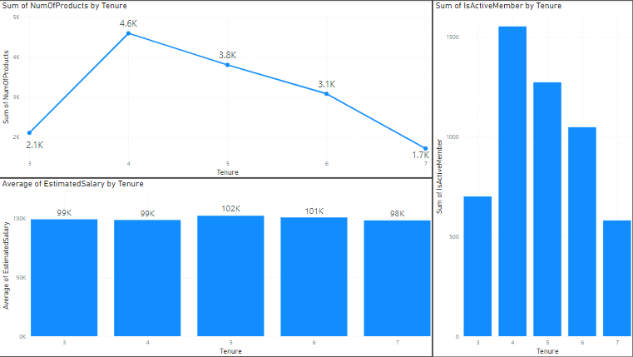
Customer Behaviour Analysis

Slide 15
Customer Behaviour Analysis
From the above data it can be observed that old customers spend less on buying products and are less active as compared to those customers who have completed around 4 years with the bank.
From the pattern it can said that as the customers spends the time in bank, they become less active and spend less on buying the product.

Slide 16
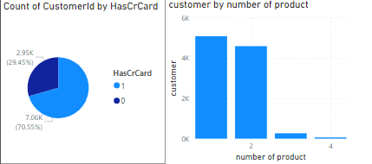
Product Affinity Study

Slide 17
Product Affinity Study
The credit card facility of the bank is most common service of the bank used by over 70% of the customers.
Most of the customers buy mostly one or two products from the bank.

Slide 18
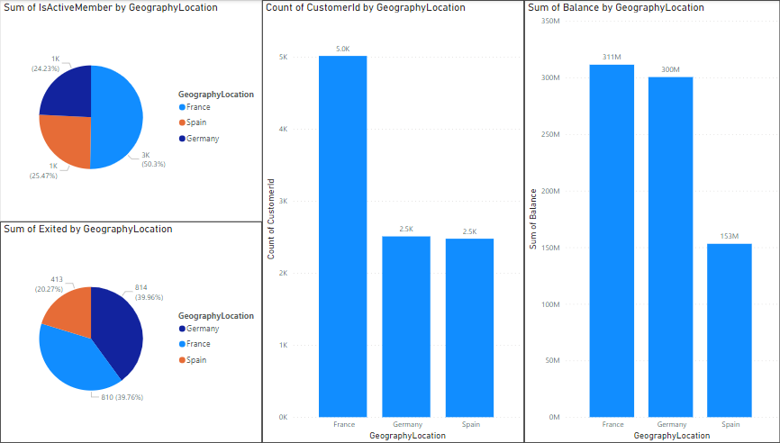
Geographic Market Trends

Slide 19
Geographic Market Trends
According to the geographic trends, the number of customers from France(5014) is double than the customers from Germany(2509) and Spain(2477). But the balance of account is almost equal for France(311 Million) and Germany(300 Million) and half of that is of Spain(153 Million).

Slide 20
Geographic Market Trends
It can be seen that out of the total customers of different countries following of them are active –
France – 2591 out of 5014
Germany – 1248 out of 2509
Spain – 1312 out of 2477
Out of the total active members France has 50% of the total active member then Spain 26% then Germany.24%

Slide 21
Geographic Market Trends
It can also be seen that out of the total customers of different countries following of them have exited the bank –
France – 810 out of 5014
Germany – 814 out of 2509
Spain – 413 out of 2477
Out of the total customers who left the bank France has 40% of the total exited customers then Germany 40% then Spain 20%.

Slide 22
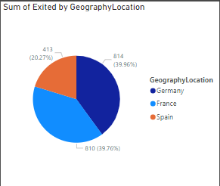
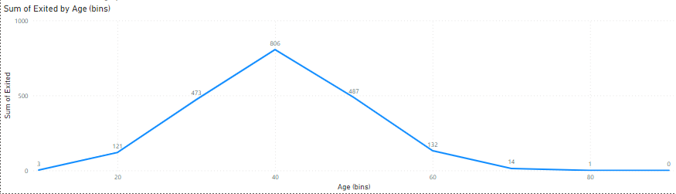
Risk Management Asset

Slide 23
Risk Management Asset
The customers who are of the age between 40-50 are leaving the bank at very high rate which can turn into financial loss to the bank.
Also people from Germany and France are leaving the bank which could turn into financial loss.

Slide 24
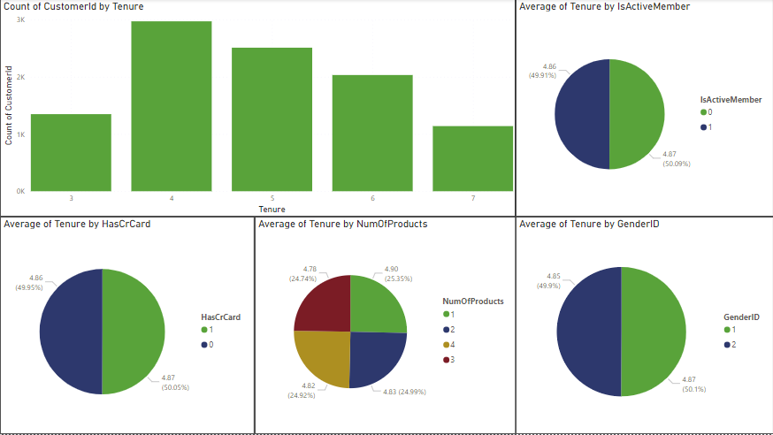
Customer Tenure Value Forecast
On observing the data we can predict that most of the customers in every segment have an average tenure of 5 years.

Slide 25
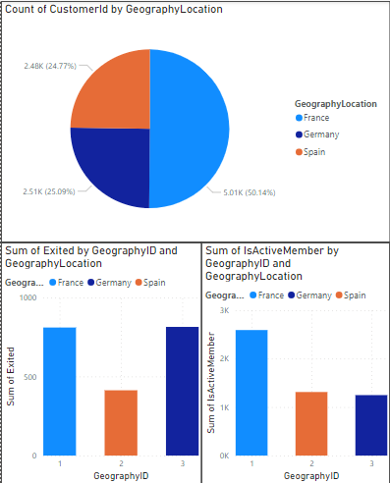
Marketing Campaign Effectiveness

Slide 26
Marketing Campaign Effectiveness
The bank should focus on area where the exit rate is high, from the above graph it can be seen that France & Germany has high exit and also bank should focus on the areas which have less active members like Germany & Spain.
Through the marketing campaign bank should promote its scheme and motivate the people of particular areas to join the bank.
To make the marketing campaign more effective, following points may help-
If we could know the bank locations whether in remote area or in main city.
Number of bank available in any area.
What facilities people aspect from the bank

Slide 27
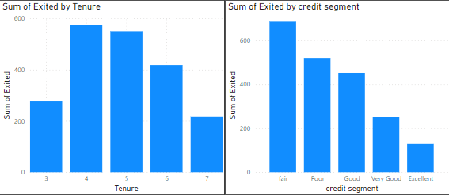
Customers Exit Reasons Exploration

Slide 28
Customers Exit Reasons Exploration
From the graphs, it can be seen that customers after completing 4-5 years start leaving the bank.
Also, customers with low credit score leave the bank.
Reasons for leaving-
May be people are coming to a location for job and after completing 4-5 years they get transferred.
May be people are not liking the services provided by the bank like high credit interests, low returns etc.

Slide 29
Prediction of future churn
Some of important factors to predict the future –
Tenure
Number Of Products
Is Active Member
Some of the outputs from these factors are –
Customers after completing 4-5 years with bank are leaving the bank
Customers before leaving the bank are inactive
Customers who bought only one product have high chance of leaving the bank

Slide 30
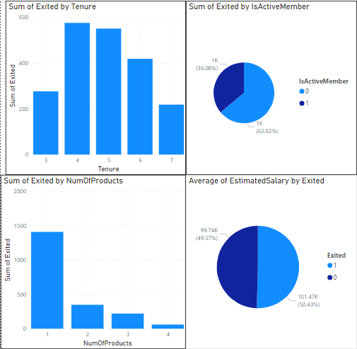
Prediction of future churn

Slide 31
Churn Rate

Slide 32
Churn Rate
Current churn rate is 20.37%.
From the graphs, it can be seen that customers after completing 4-5 years start leaving the bank.
Also, customers with low credit score leave the bank.
Reasons for leaving-
May be people are coming to a location for job and after completing 4-5 years they get transferred.
May be people are not liking the services provided by the bank like high credit interests, low returns etc.

Slide 33
Churn Rate
Remedies to decrease the churn rate –
Personalized offers and discount
Enhanced customer service and support
Loyalty programs and rewards
Proactive engagement for at-risk customers

Slide 34
Recommended Actions
To reduce the churn rate bank should focus on the below points-
Develop targeted retention strategies:
Personalized offers and discount
Enhanced customer service and support
Loyalty programs and rewards
Proactive engagement for at-risk customers

Slide 35
Thank You

